Slide 1





Theme 2 - Developing an All-Purpose Web or Mobile App for Students
1
TI Confidential – NDA Restrictions

Slide 2


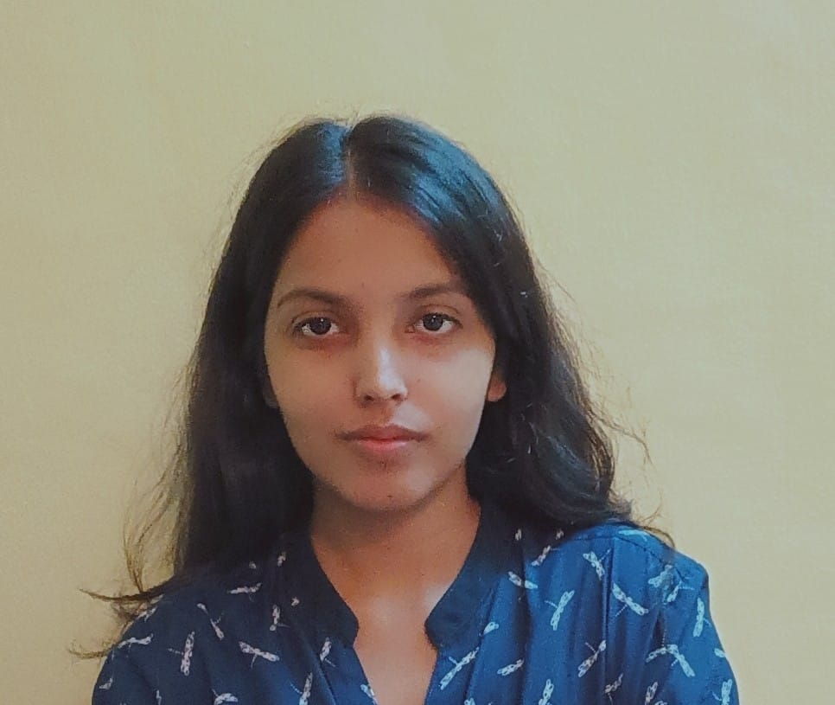

Meet the Team - Aveanfighters
MENTOR – Koushik Anche
Khushi Singh
NIT Surat
Lakshmi C
IIT Guwahati
Sonika Kumari
IGDTUW
2
TI Confidential – NDA Restrictions

Slide 3
Agenda
Problem Statement/Objective
Architecture Diagram
UI/UX Mock Ups
Data Flow Diagram
Tech Stack Selection and Reason
Outcome/Demo
Individual Team Member Contribution
Novelty/Innovation
Future Scope
References
2
TI Confidential – NDA Restrictions

Slide 4

Problem Statement and Objectives
Students, professors, and administrators rely on multiple disconnected platforms for academic management.
This fragmented system leads to inefficiencies, miscommunication, and security risks.
So, the main purpose is to design and implement an all-purpose app that serves as a centralized platform for college students. professors and administrators.
GOOGLE CLASSROOM
There are so many apps in my phone after coming to college and the sole purpose of all of them is to do college work.
Let me mention some of them.
SELF ATTENDANCE
GOOGLE DRIVE
DISCORD
IMAGE CREDIT - www.animalia-life.club
TI Confidential – NDA Restrictions

Slide 5

Problem Statement and Objectives
📴🔄 Enable offline functionality so users can access critical features without an internet connection, with seamless data synchronization once online.
Streamline academic and administrative tasks by integrating essential features into a single, easy-to-use platform.
🎨🖥️ Create an intuitive and user-friendly interface that enhances accessibility and engagement for all users.
💡⚙️ Incorporate innovative functionalities to improve efficiency and elevate the digital experience for educational institutions.
GIRL : I was absent from the past 10 days, as I was having viral fever and now I am unable to calculate how many classes of which professor I have missed because some of the classes were cancelled.
GIRL :Also, I am having difficulty in keeping a record of how many assignments I have missed to submit.
BOY: Yesterday, there was no network in the boys hostel and I was unable to access my student’s account.
Image credit – alamy.com
TI Confidential – NDA Restrictions

Slide 6


Problem Statement and Objectives
🔒✅ Ensure secure authentication mechanisms to protect user data and prevent unauthorized access.
👥🔑 Implement role-based access control to provide tailored permissions for different user groups (students, professors, and administrators).
🚀🛠️ Leverage modern security technologies to safeguard sensitive information and prevent breaches.
👥🔑 Temporary Role Escalation with Audit Trails : Introduce a controlled, temporary privilege escalation feature for roles such as student leaders or peer mentors
There have been some incidents in college,
Some data has been leaked and attendance and marks have been manipulated, when I was not there in college.
Image credit – freepik.com
5
TI Confidential – NDA Restrictions

Slide 7
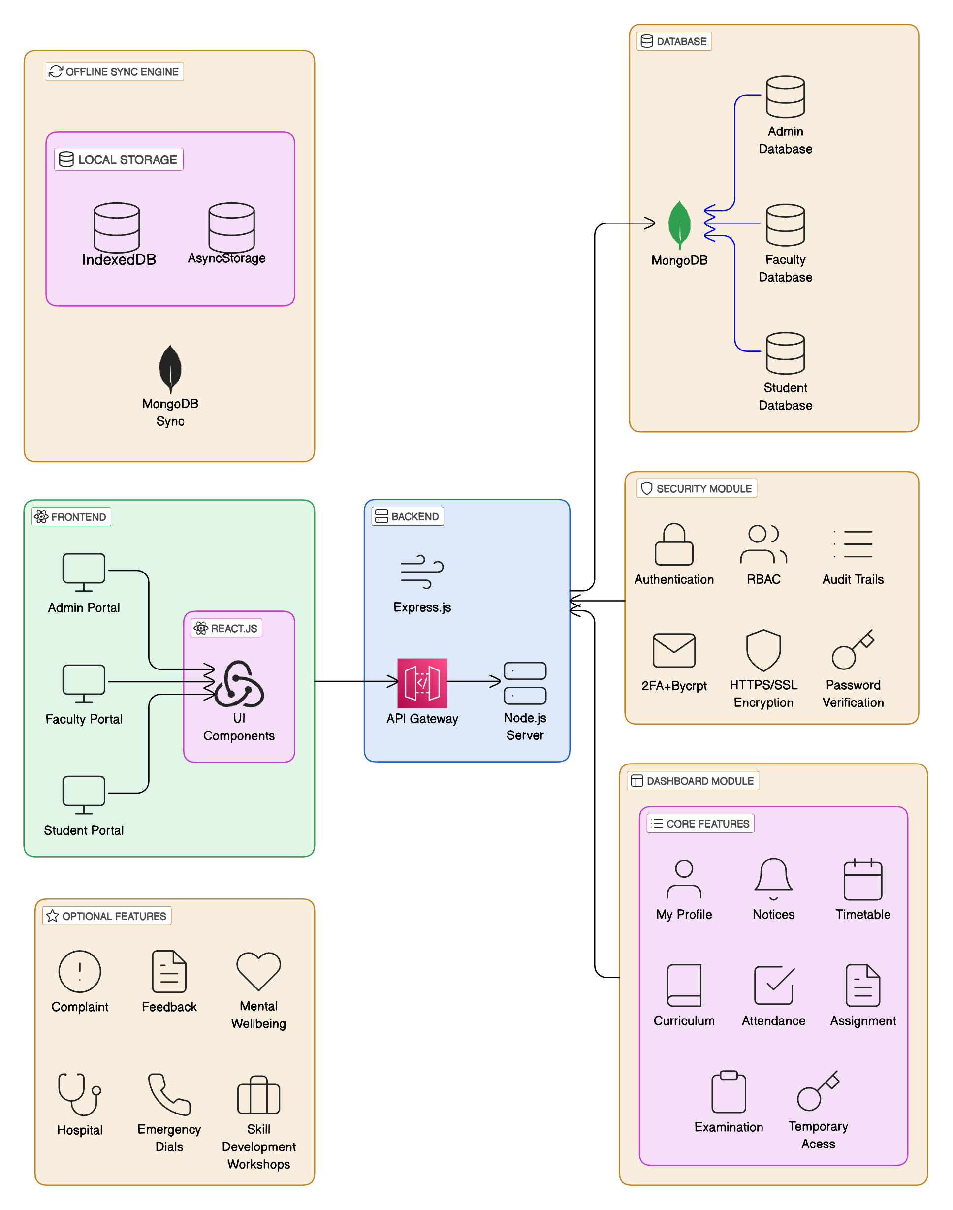
Architecture Diagram
6
TI Confidential – NDA Restrictions

Slide 8
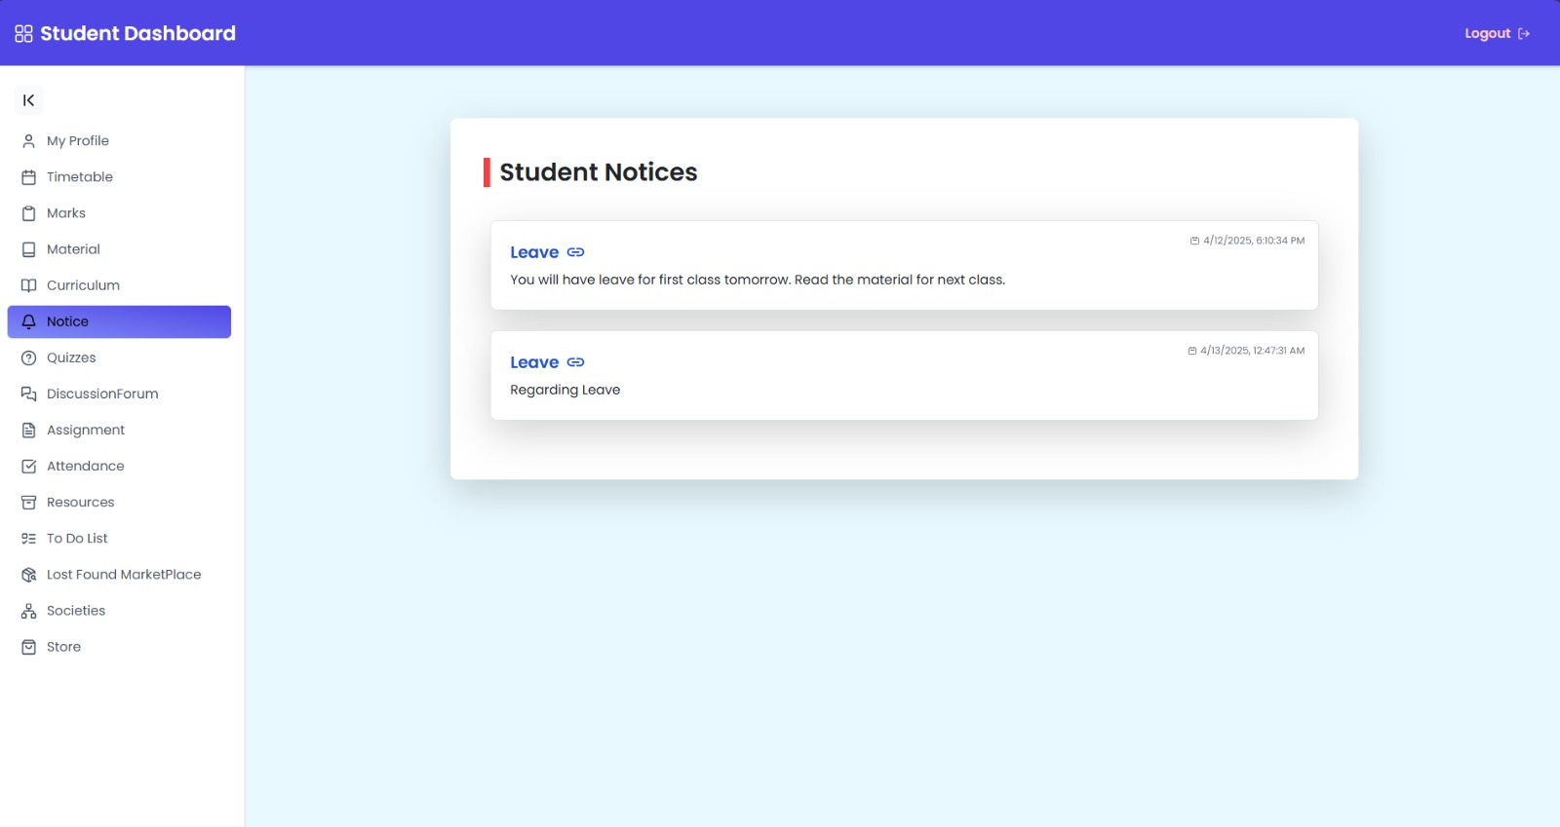
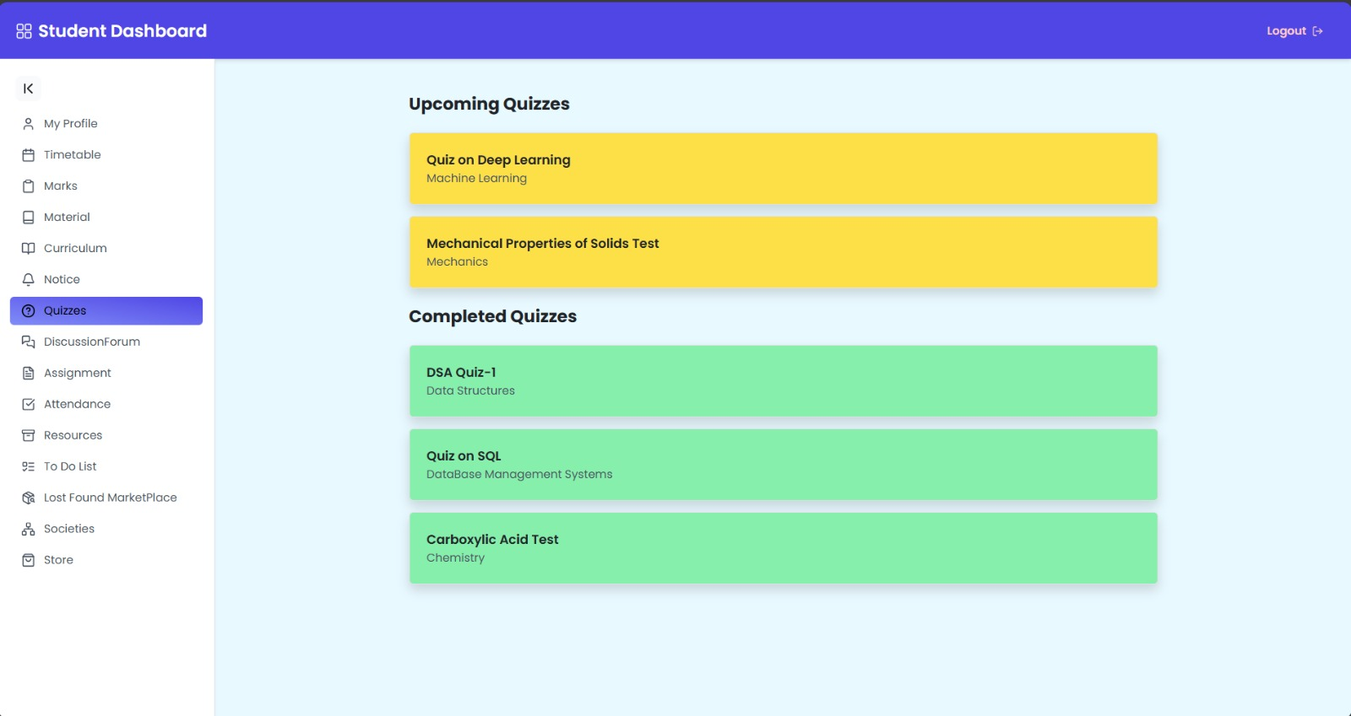
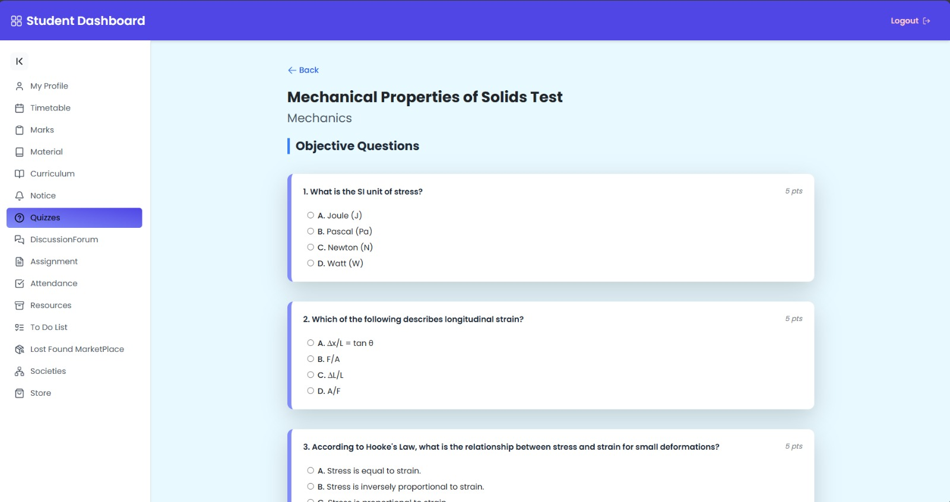
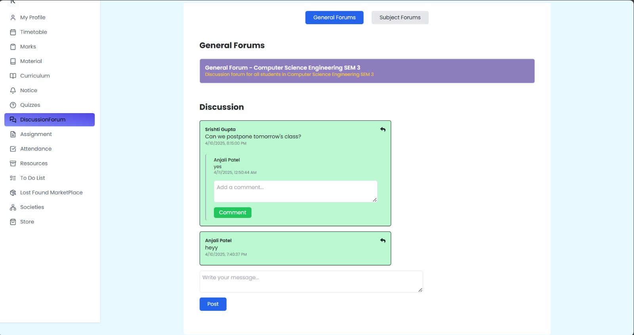
UI/UX Mock Ups
7
TI Confidential – NDA Restrictions

Slide 9
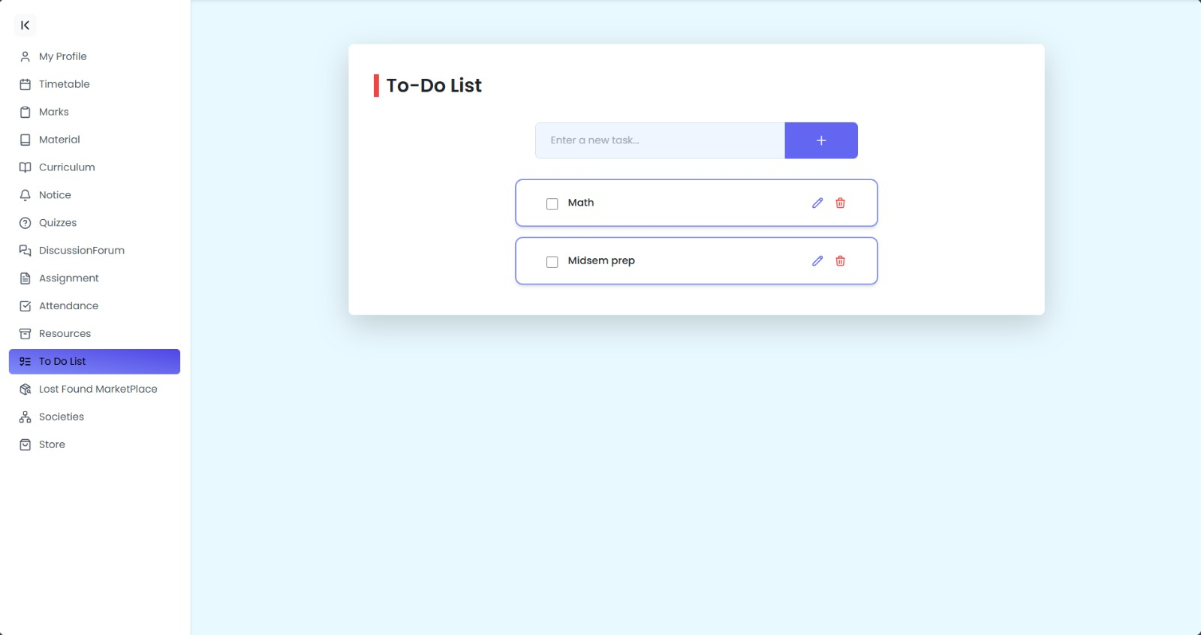
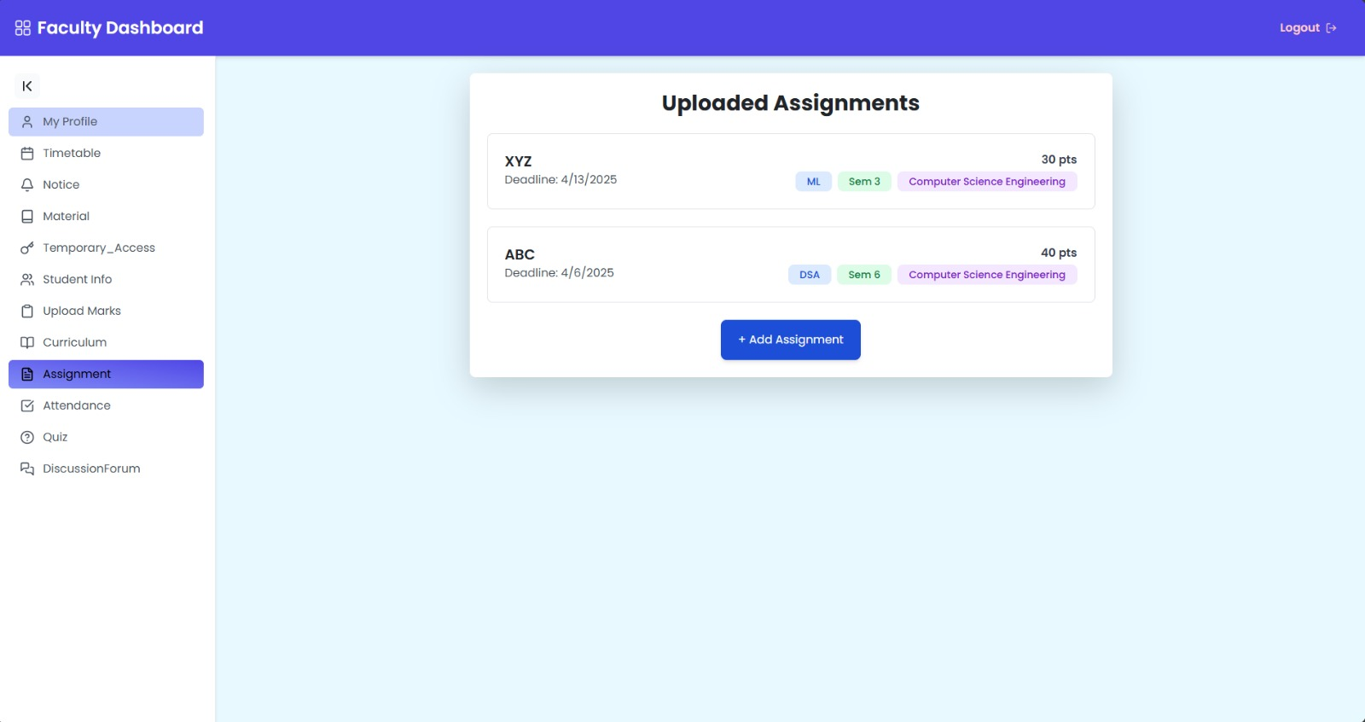
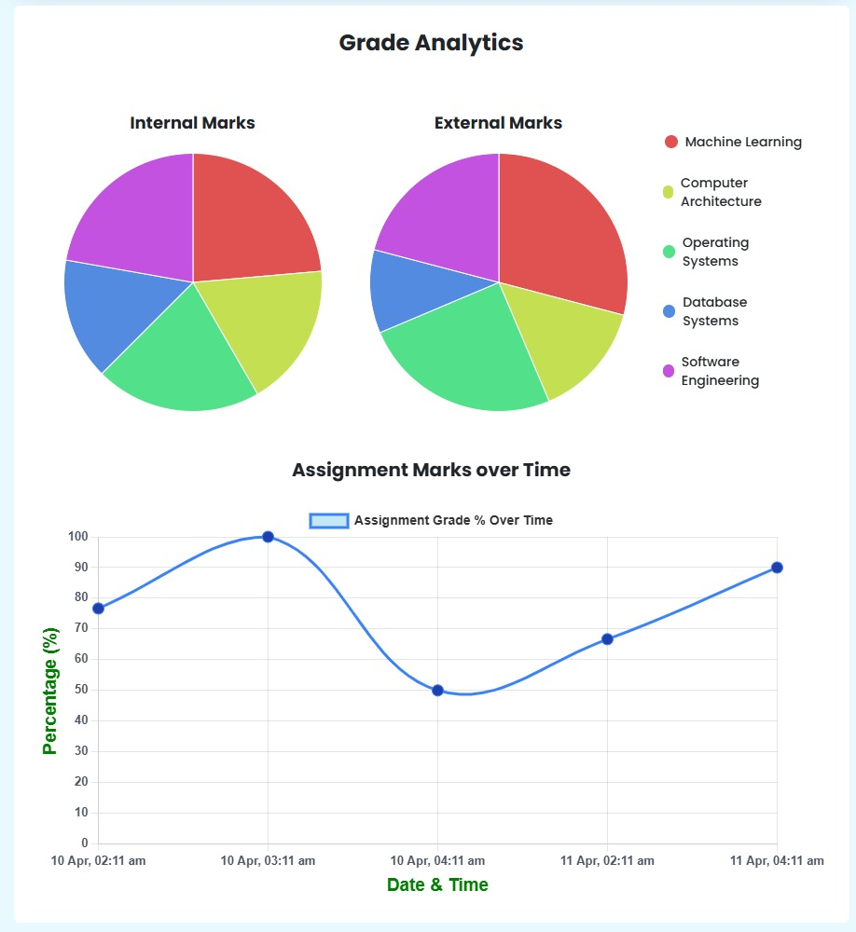
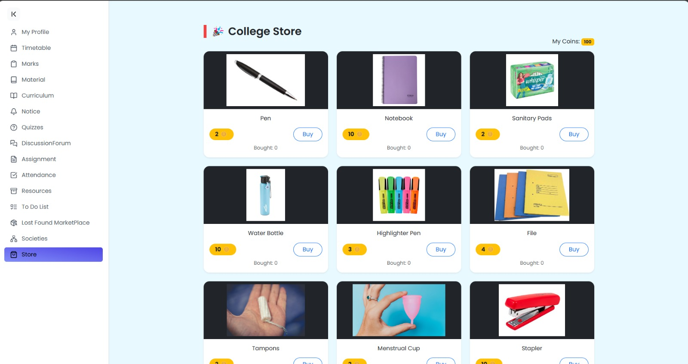
UI/UX Mock Ups
7
TI Confidential – NDA Restrictions

Slide 10
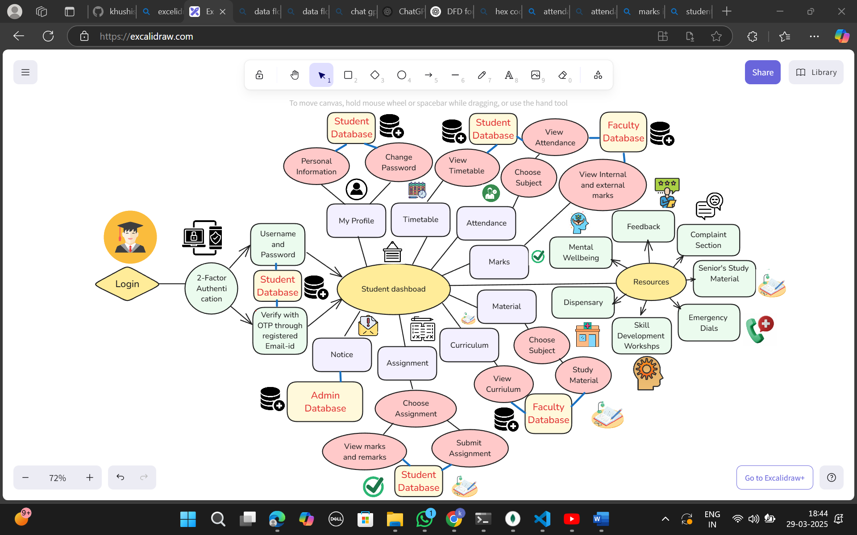
Student Data Flow Diagram
17
TI Confidential – NDA Restrictions

Slide 11
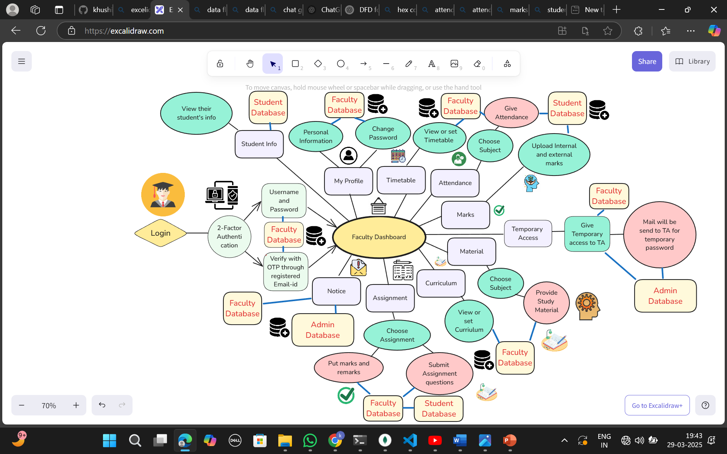
Faculty Data Flow Diagram
18
TI Confidential – NDA Restrictions

Slide 12
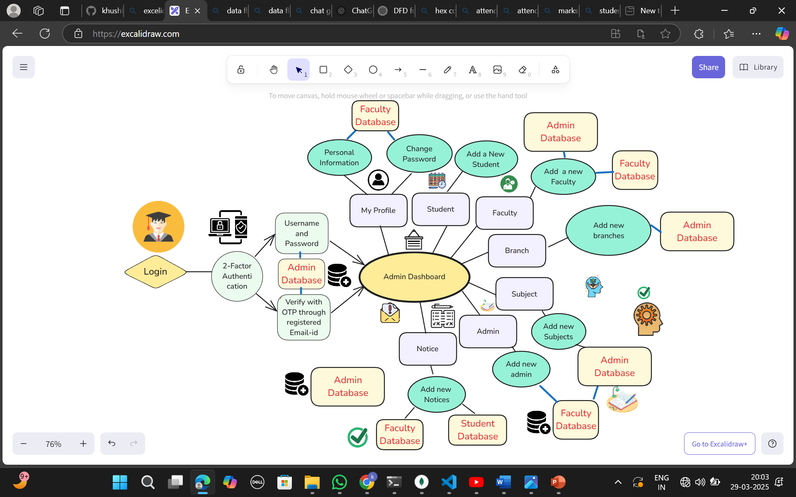
Admin Data Flow Diagram
19
TI Confidential – NDA Restrictions

Slide 13

TechStack Selection and Reason
MERN Stack for CollegeApp
Full-Stack JavaScript: Ensures seamless communication between frontend and backend.
Security: BCrypt.js for password hashing and 2FA with OTP using Nodemailer.
Scalability: MongoDB’s NoSQL architecture allows for horizontal scaling across multiple servers. This means more users and data can be handled without a drop in performance.
Styling: TailwindCSS for highly customizable, responsive, and modern UI. It is ideal for crafting sleek and professional interfaces.
Fast Development: Reusable components in React and middleware support in Express.js reduce development time
Real-time Updates: WebSockets can be used for live notifications (e.g., assignment updates, new marks)
Offline Mode: IndexedDB enables seamless offline access and syncing with the backend once online.
2
TI Confidential – NDA Restrictions

Slide 14
TechStack Selection and Reason
WHY?
MongoDB stores data in JSON-like documents, making it faster for retrieving and processing data compared to relational databases.
ReactJs offers a fast, scalable, and modular frontend with a component-based architecture, Virtual DOM for performance and hooks for state management.
ReactJS integrates well with Tailwind CSS for styling.
Nodemailer is chosen because it’s lightweight, reliable, and works well with SMTP providers like Gmail, and Outlook.
BCrypt.js is widely used because it uses salted hashing, making it computationally expensive for attackers to crack passwords.
Express.js with Node.js provides a lightweight, scalable, and high-performance backend with asynchronous architecture for handling multiple requests efficiently. It supports middleware for security & authentication and integrates seamlessly with MongoDB for flexible, high-speed data handling.
2
TI Confidential – NDA Restrictions

Slide 15
Individual Team Member Contribution – Sonika Kumari
Automated Mail
Seamless Online & Offline Functionality
Attendance System
Examination Section
Feedback
Indexed DB
Node Crone Node Mailer
Format Api
TI Confidential – NDA Restrictions

Slide 16
INDIVIDUAL CONTRIBUTION - KHUSHI SINGH
CONTEXT- AWARE ADAPTIVE AUTHENTICATION
CHANGING OF PASSWORD
CURRICULUM AND STUDY MATERIAL
PASSWORD ENCRYPTION
EXPORT
FEATURE
NOTICE
BRANCH AND SUBJECTS
LOST FOUND AND MARKETPLACE
RESOURCES DASHBOARD
MULTI-FACTOR AUTHENTICATION
TIMETABLE
ADDITION FEATURE
TEMPORARY ROLE ESCALATION
MARKS
TO DO LIST
STUDENT INFORMATION
SOCIETIES
COLLEGE STORE
2
TI Confidential – NDA Restrictions

Slide 17
Individual Team Member Contribution – Lakshmi C
LAKSHMI C
QUIZ GENERATION FROM PDF WITH AI
OFFLINE FEATURES AND SECURE AUTO-SYNC
QUIZ AUTO-EVALUATION
ASSIGNMENTS (UPLOAD, SUBMIT, GRADE, DOWNLOAD)
INTEGRATION WITH SERVICE WORKERS
STUDENT PERFORMANCE
ANALYTICS
DISCUSSION FORUM (GENERAL AND SUBJECT-WISE)
STYLING
2
TI Confidential – NDA Restrictions

Slide 18



Novelty/Innovation
📚 The Resources Dashboard is a pioneering feature that centralizes essential student services, addressing critical gaps in resource accessibility, well-being, and skill development.
🚀Unlike traditional college management systems, which primarily focus on academic tracking, our dashboard extends support beyond academics to ensure a holistic student experience.
27
TI Confidential – NDA Restrictions

Slide 19
🚀 Key Innovations
💬 Feedback System
Provides a structured channel for students and faculty to share concerns, suggestions, and improvements.
⚖️ Complaint System
A streamlined interface for submitting complaints related to campus facilities, administration, or academics.
🏥 Health & Emergency System
🩺 On-Demand Dispensary Assistance: Students can book appointments, access medical history, and receive prescriptions digitally.
📞 Emergency Dial Feature: Quick access to security, medical, and administrative helplines for immediate assistance.
🎓 Skill Development & Career Growth system
A dedicated section for workshops, hackathons, and industry webinars to foster skill enhancement.
🧠 Mental Well-Being & Counseling Services
🔒 Anonymized mental health support system with access to certified counselors.
28
TI Confidential – NDA Restrictions

Slide 20
Future Scope
🔄 AI-Powered Personalization
Integrate AI models to recommend study resources based on performance and interests.
Personalized notifications for deadlines, events, and academic milestones.
🌐 Integration with National Academic Platforms
Sync with platforms like DigiLocker, NAD, and university ERP systems for document verification and academic record sharing.
🧠 AI Academic Mentor
Create an AI-powered academic advisor that helps students choose electives, plan study schedules, and set goals based on past performance and interests.
Adaptive study paths tailored for each student.
Gamified Learning & Leaderboards
Add a gamification layer where students earn points, badges, and ranks based on class participation, quiz performance, and assignments.
2
TI Confidential – NDA Restrictions

Slide 21
🚀 References
MongoDB Documentation: https://www.mongodb.com/docs/atlas/
NodeJS Documentation: https://nodejs.org/api/all.html
ExpressJS Documentation: https://expressjs.com/
ReactJs Documentation: https://react.dev/reference/react
MERN Stack tutorial: https://www.youtube.com/watch?v=98BzS5Oz5E4&list=PL4cUxeGkcC9iJ_KkrkBZWZRHVwnzLIoUE
MongoDB tutorial: https://www.youtube.com/watch?v=ExcRbA7fy_A&list=PL4cUxeGkcC9h77dJ-QJlwGlZITd4ecZOA
NodeJS tutorial: https://www.youtube.com/watch?v=zb3Qk8SG5Ms&list=PL4cUxeGkcC9jsz4LDYc6kv3ymONOKxwBU
Indexed DB basics tutorial: https://www.youtube.com/watch?v=yZ26CXny3iI
28
TI Confidential – NDA Restrictions

